Slide 1
Fair Use
INFO 4940/5940
Instructor: Mike Priehs
March 24, 2025

Slide 2
Last Week’s Topics
Rights Pt. II
Distribution
Performance
Exceptions & Limitations

Slide 3
Fair Use
The History of Fair Use

Slide 4
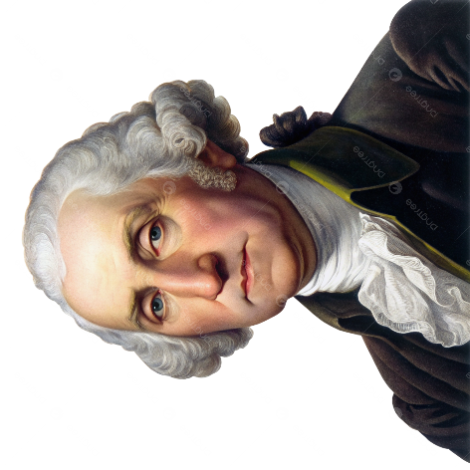
Folsom v. Marsh (1841)
Regarded as the first “Fair Use” case
Rev. Charles Wentworth Upham copied 353 pages from Folsom’s 12-volume biography of George Washington
Folsom sued for “piracy of the copyright”
Defendant argued papers were not copyrightable because they were the letters of a deceased author, they were not private property and not “proper subjects of copyright,” and because they were works of the President, should belong to the U.S.A.
Court said the letters were copyrightable. Court accepted that some uses could be “fair,” but rejected claim that this particular use was fair

Slide 5
Folsom v. Marsh (1841)
“In deciding whether to excuse a particular use, one should look to the nature and objects of the selections made, the quantity and value of the materials used, and the degree in which the use may prejudice the sale, or diminish the profits, or supersede the objects of the original work.”
- Judge Joseph Story

Slide 6
Fair Use Codified - 17 USC § 107
Fair Use is for the following purposes:
        Criticism
Comment
New reporting
Teaching (including multiple copies for classroom use)
Scholarship
Fair Use is not an infringement of copyright. It is a statutory limitation.
Notwithstanding the provisions of sections 106 and 106A, the fair use of a copyrighted work, including such use by reproduction in copies or phonorecords or by any other means specified by that section, for purposes such as criticism, comment, news reporting, teaching (including multiple copies for classroom use), scholarship, or research, is not an infringement of copyright. In determining whether the use made of a work in any particular case is a fair use the factors to be considered shall include—

Slide 7
Fair Use Codified - 17 USC § 107
(1) the purpose and character of the use, including whether such use is of a commercial nature or is for nonprofit educational purposes;
(2) the nature of the copyrighted work;
(3) the amount and substantiality of the portion used in relation to the copyrighted work as a whole; and
(4) the effect of the use upon the potential market for or value of the copyrighted work.
The fact that a work is unpublished shall not itself bar a finding of fair use if such finding is made upon consideration of all the above factors.

Slide 8
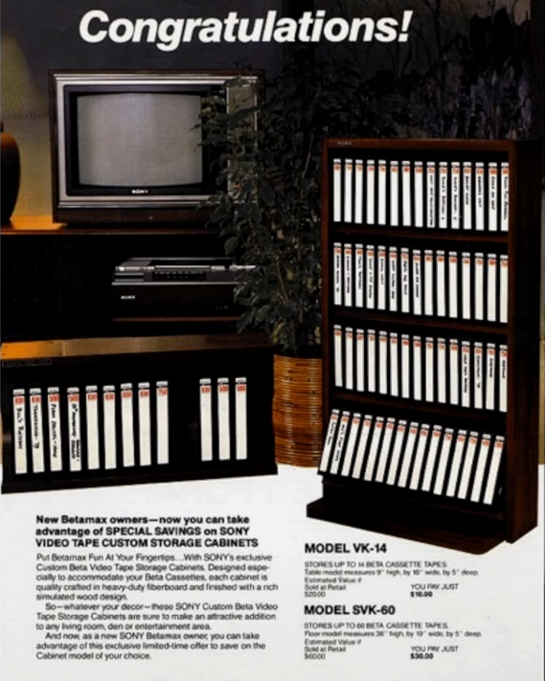
Sony Corporation v. Universal City Studios
“Betamax” case
Decided 1984
SCOTUS found that making individual copies of complete television shows for the purposes of “time shifting” does not constitute copyright infringement

Slide 9
 | Sony
1. Purpose and character of use
2. Nature of copyrighted work
3. Amount of copying | Neutral
4. Impact on potential market

Slide 10
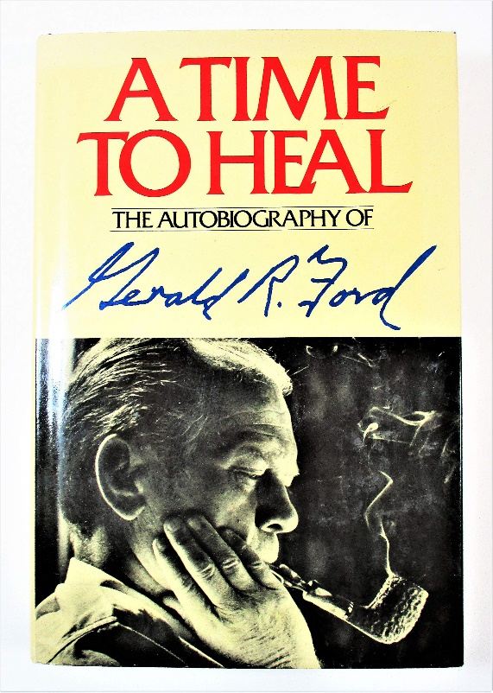
Harper & Row v. Nation Enterprises
The Nation magazine published 300-400 words of verbatim quotes from President Gerald Ford’s book, “A Time to Heal” without permission
Decided 1985
SCOTUS rejected the fair use defense
https://www.amazon.com/Time-Heal-Autobiography-Gerald-Ford/dp/0060112972

Slide 11
 | Harper & Row
1. Purpose and character of use
2. Nature of copyrighted work
3. Amount of copying
4. Impact on potential market

Slide 12
Fair Use
Fair Use Today

Slide 13
1. The Purpose and Character of the Use
Subfactors:
Commercial or Non-commercial
Transformative
Shady/Illicit
Customary

Slide 14
2. Nature of the Copyrighted Work
Subfactors:
Published or Unpublished
Creative or Factual
Computer Software

Slide 15
3. Amount Used
Subfactors:
Quantitative
Qualitative

Slide 16
4. Impact on Potential Market
Subfactors:
Do not count as “harm”:
  Loss of fee that defendant would have paid plaintiff
  Ability to charge people interested in making transformative uses
  Injuries resulting from criticism
  Impairment of the markets for other works owned by plaintiff

Slide 17
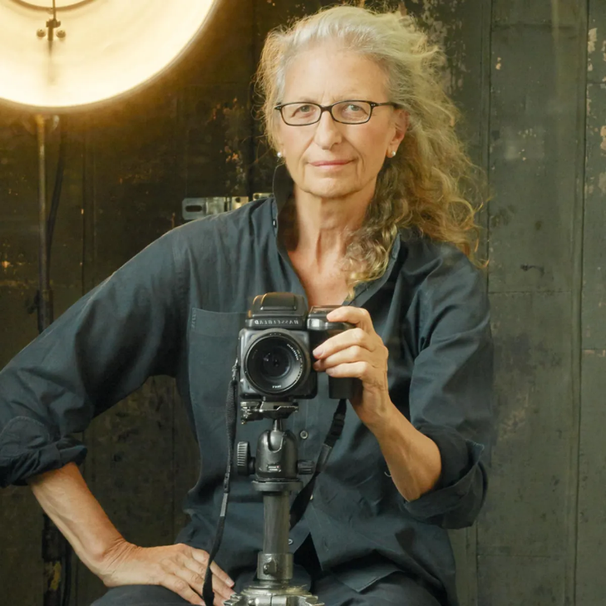
Leibovitz v. Paramount Pictures Corp. (1998)
Second Circuit Court of Appeals (137 F.3d 109)
Plaintiff: Annie Leibovitz, professional portrait photographer
Defendant: Paramount Pictures Corp.
Leibovitz produced a famous nude photo of a pregnant Demi Moore for Vanity Fair
Paramount’s promotional material for Naked Gun 33 1/3 featured Leslie Nielsen’s face superimposed on a similar nude pregnant body

Slide 18
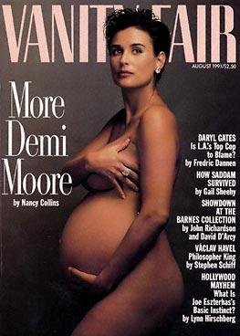
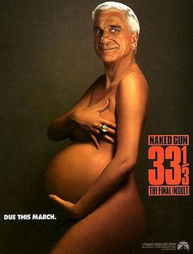
Leibovitz v. Paramount Pictures Corp. (1998)
Court's Findings
Parody: The court found Paramount's use to be a parody of Leibovitz's photograph
Fair Use Upheld: The court ruled that the use was fair use
Purpose and Character: The advertisement was transformative and parodic
Market Impact: The parody did not serve as a market substitute for the original photograph
Verdict
The court affirmed that Paramount's use of the photograph was protected by fair use
https://en.wikipedia.org/wiki/Leibovitz_v._Paramount_Pictures_Corp.#/media/File:Vanity_Fair_August_1991.JPG
https://en.wikipedia.org/wiki/Leibovitz_v._Paramount_Pictures_Corp.#/media/File:Naked_gun_three.jpg

Slide 19
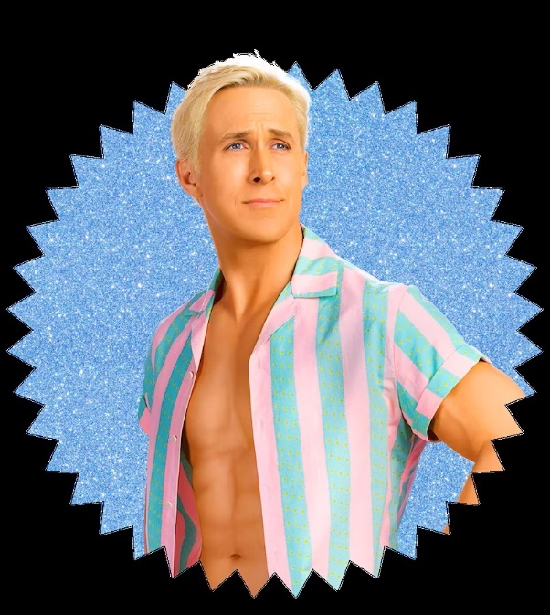
Mattel Inc. v. Walking Mountain Prods. (2003)
Ninth Circuit Court of Appeals (353 F. 3d 792)
Plaintiff: Mattel Inc. (Manufactuerer of Barbie Dolls)
Defendant: Tom Forsythe (Photographer & Owner of Walking Mountain Prods.)
Mattel claimed that Forsythe use of Barbie dolls in his photos infringed on their copyrights
Forsythe argued his work was a parody and social critique, thus protected under fair use

Slide 20
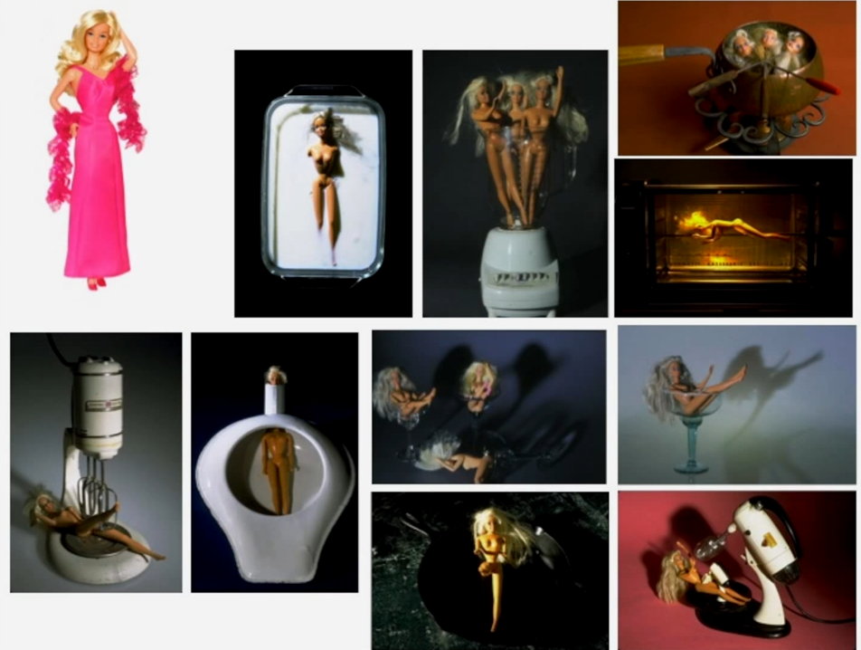
Mattel Inc. v. Walking Mountain Prods. (2003)
Court's Findings
Transformative Use: The court found Forsythe's work to be highly transformative and parodic
Fair Use Upheld: The court ruled that Forsythe's use of Barbie dolls was fair use
Purpose and Character: The work was a social critique and parody, reducing the significance of its commercial nature
Market Impact: Forsythe's work was unlikely to substitute for Mattel's products
Verdict:
The court affirmed that Forsythe's use of Barbie dolls in his photographs was protected by fair us

Slide 21
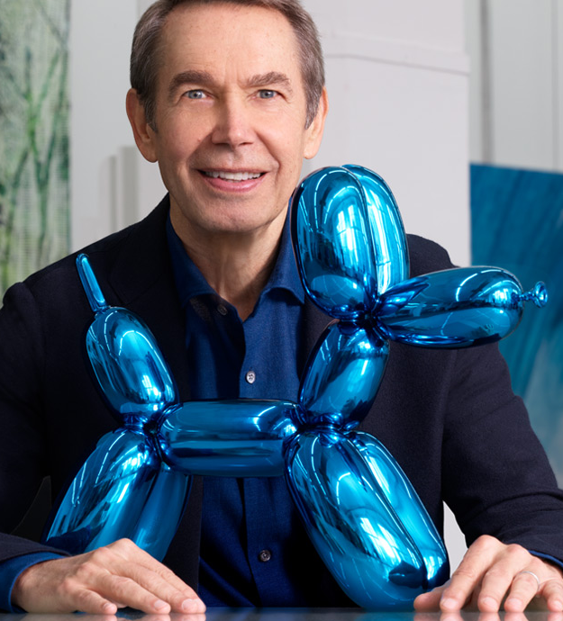
Rogers v. Koons (1992)
Second Circuit Court of Appeals (960 F.2d 301)
Plaintiff: Art Rogers, photographer
Defendant: Jeff Koons, internationally known artist
Rogers sued Koons for copying his photograph
Koons claimed his sculpture was a parody (thus, fair use)

Slide 22
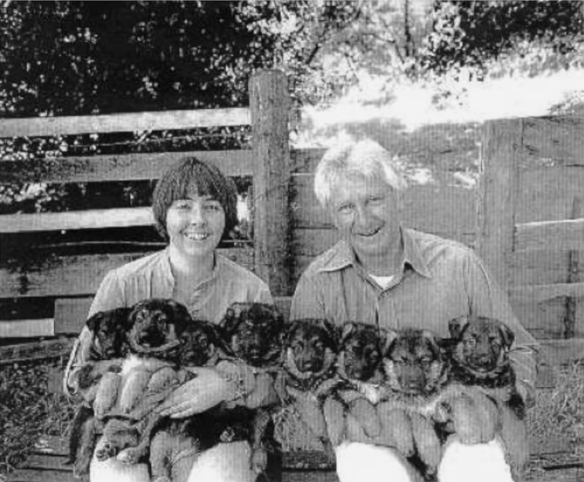
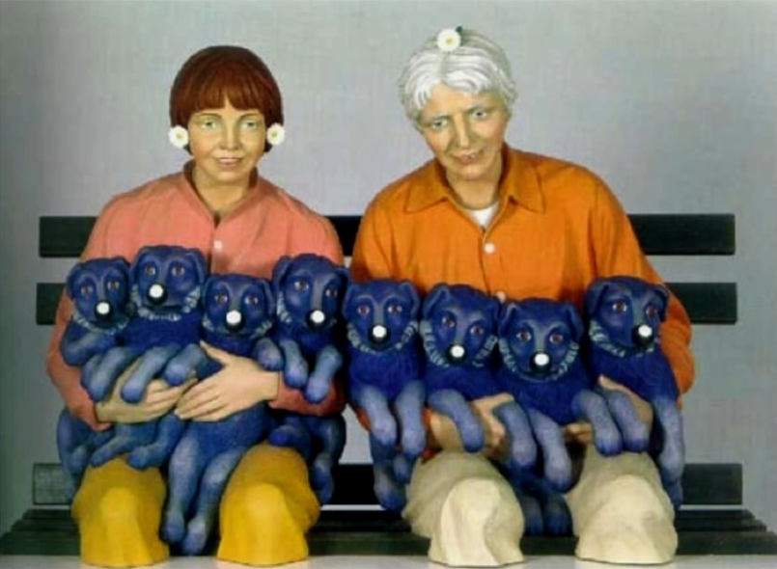
Rogers v. Koons (1992)
Court’s Findings
Substantial Similarity: The sculpture was found to be a close copy of the photo.
Fair Use Rejected: Koons’ work did not qualify as a parody
Purpose and Character: Koons’ work was primarily commercial and done in bad faith
Market Harm: Copying prejudiced the market for Roger’s photo
Verdict
The court affirmed the Koons’ use of the photo was not fair

Slide 23
Fair Use
Is It a Fair Use?

Slide 24
It’s fair use if you don’t make money from it
Courts weigh noncommercial, non-profit, and educational uses in favor of a finding of fair use. But this myth ignores the holistic and fact specific nature of the fair use test—and the other three factors that a court must consider.
Many times, for-profit uses have been found to be a fair use.

Slide 25
If it's published openly on the Internet, I'm free to copy and repost at will
Just because a work is publicly accessible, available for anyone to read or download on the Internet, doesn't mean it's in the public domain, or not subject to copyright protections. In fact, those two concepts have nothing to do with one another.
Nearly all work published on the Internet is subject to copyright protections.
Every work of original creation that is written, recorded, notated, drawn, photographed, or otherwise captured - including a work published on the Internet - is protected by copyright.

Slide 26
Crediting the copyright owner of the original work makes the resulting use a fair use
Copyright and plagiarism are not the same. Plagiarism occurs when someone tries to pass off someone else’s work or ideas as their own­; it is an ethical violation but likely does not violate any laws. Copyright infringement on the other hand occurs when someone reproduces, distributes, publicly performs or display, or prepares derivatives works of a copyrighted work without the copyright owners’ permission; it is a violation of the law (unless an exception, like fair use, applies)

Slide 27
Using just a few seconds or snippets of someone else’s copyrighted work qualifies as a fair use
There are no bright line rules on how much of a copyrighted work can be used to qualify for the fair use exception.
It’s important to keep in mind, that while the third factor does look at the “amount” used—with higher amounts generally being less favorable for this factor— “substantiality” of the portion used—i.e. whether it is the “heart” of the work—is also important.

Slide 28
Stating “No Copyright Infringement Intended” or “This is Fair Use” on Social Media Makes a Use a Fair Use
There are no magic disclaimers such as saying things like “no copyright infringement intended” or “no copyright intended” that would shield a social media user from copyright infringement claims under the fair use doctrine.

Slide 29
Fair Use
Other Approaches

Slide 30
Countries with Exceptions Similar to Fair Use
Sri Lanka (2003)
Singapore (2004)
Israel (2007)
South Korea (2011)
Philippines (2012)

Slide 31
Sri Lanka (2003)
(2) The following factors shall be considered in determining whether the use made of a work in any particular case is fair use :—
(a) the purpose and character of the use, including whether such use is of a commercial nature or is for non-profit educational purposes ;
(b) the nature of the copyrighted work ;
(c) the amount and substantiality of the portion used in relation to the copyrighted work as a whole ; and
(d) the effect of the use upon the potential market for, or value of, the copyrighted work.

Slide 32
Singapore (2004)
For the purposes of this Act, the matters to which regard shall be had, in determining whether a dealing with a literary, dramatic, musical or artistic work or with an adaptation of a literary, dramatic or musical work, being a dealing by way of copying the whole or a part of the work or adaptation, constitutes a fair dealing with the work or adaptation for any purpose other than a purpose referred to in section 36 or 37 shall include —
(a) the purpose and character of the dealing, including whether such dealing is of a commercial nature or is for non-profit educational purposes;
(b) the nature of the work or adaptation;
(c) the amount and substantiality of the part copied taken in relation to the whole work or adaptation;
(d) the effect of the dealing upon the potential market for, or value of, the work or adaptation; and
(e) the possibility of obtaining the work or adaptation within a reasonable time at an ordinary commercial price.

Slide 33
Israel (2007)
(b) In determining whether a use made of a work is fair within the meaning of this section the factors to be considered shall include, inter alia, all of the following:
(1) The purpose and character of the use;
(2) The character of the work used;
(3) The scope of the use, quantitatively and qualitatively, in relation to the work as a whole;
(4) The impact of the use on the value of the work and its potential market.
(c) The Minister may make regulations prescribing conditions under which a use shall be deemed a fair use.

Slide 34
South Korea (2011)
Art 35-3: (1) Other than the cases stipulated from Article 23 to Article 35–2, Article 101–3 to Article 101–5 it shall be permissible to use works for purposes such as news reporting, criticism, education, or research which do not conflict with a normal exploitation of the work and do not unreasonably prejudice the legitimate interests of the right holder.
(2) The following four factors must be considered in determining whether a particular use is fair:
1. the purpose and character of the use, including whether such use is of commercial nature or is for nonprofit purposes;
2. The nature of the copyrighted work;
3. Amount and substantiality of the portion used in relation to the copyrighted work as a whole; and
4. The effect of the use upon the actual and potential market or value of the copyrighted work.

Slide 35
Philippines (2012)
185.1. The fair use of a copyrighted work for criticism, comment, news reporting, teaching including multiple copies for classroom use, scholarship, research, and similar purposes is not an infringement of copyright. Decompilation, which is understood here to be the reproduction of the code and translation of the forms of the computer program to achieve the inter-operability of an independently created computer program with other programs may also constitute fair use. In determining whether the use made of a work in any particular case is fair use, the factors to be considered shall include:
(a) The purpose and character of the use, including whether such use is of a commercial nature or is for non-profit education purposes;
(b) The nature of the copyrighted work;
(c) The amount and substantiality of the portion used in relation to the copyrighted work as a whole; and
(d) The effect of the use upon the potential market for or value of the copyrighted work.
185.2. The fact that a work is unpublished shall not by itself bar a finding of fair use if such finding is made upon consideration of all the above factors.

Slide 36
Presentations on Wednesday
Campbell v. Acuff-Rose
  SCOTUS, 510 U.S. 569 (1994)
Google v. Oracle
  SCOTUS, 593 U.S. 1 (2021)
Warhol Foundation v. Goldsmith
  SCOTUS, 598 U.S. 508 (2023)

